Slide 1
Cyber Safety for Seniors
University of Louisville
CIS Department
Prepared by Daniel Aguilar

Slide 2

The Cybersecurity Environment
Technology Access
Laptops
Tablets and Phones
The Internet

Slide 3
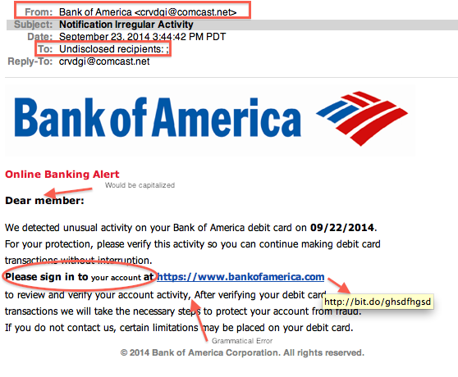
Most common cyber threats for seniors
Phishing
Emails
Phone calls and Text Messages
What to watch out for?
Emails or text messages from banks, schools, hospitals, the IRS, etc. requesting money or personal information.
Request with urgent claims, to log into an account, click on a link.
Emails or messages with file attachments, cheap graphics and/or spelling and grammar errors.
What to do if you suspect it may be a scam?
STOP. Find a different way to contact the sender or caller to verify the claim before doing anything.
Call the individual or company directly with an official number (like the one in the back of your debit card)

Slide 4
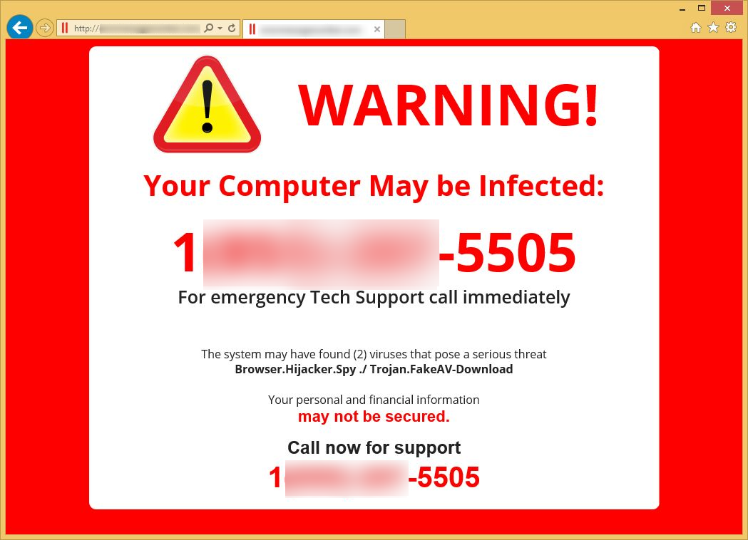
Most common cyber threats for seniors
Tech Support Scams
Scammer contacts user and convinces them their computer has been impacted by a virus or technical issue.
Scammer claims they can help them fix it if they are given remote access to the computer
What to watch out for?
Emails or text messages tech companies like Microsoft claiming there is something wrong with your computer.
Pop ups windows on websites that warn you about viruses.
Requests to install anything on your computer.
How to prevent falling victim to it?
Don’t let anyone gain remote access to your computer.
Never click on any pop up windows on websites that warn you about viruses.
Never download or install programs from unknown sources.

Slide 5
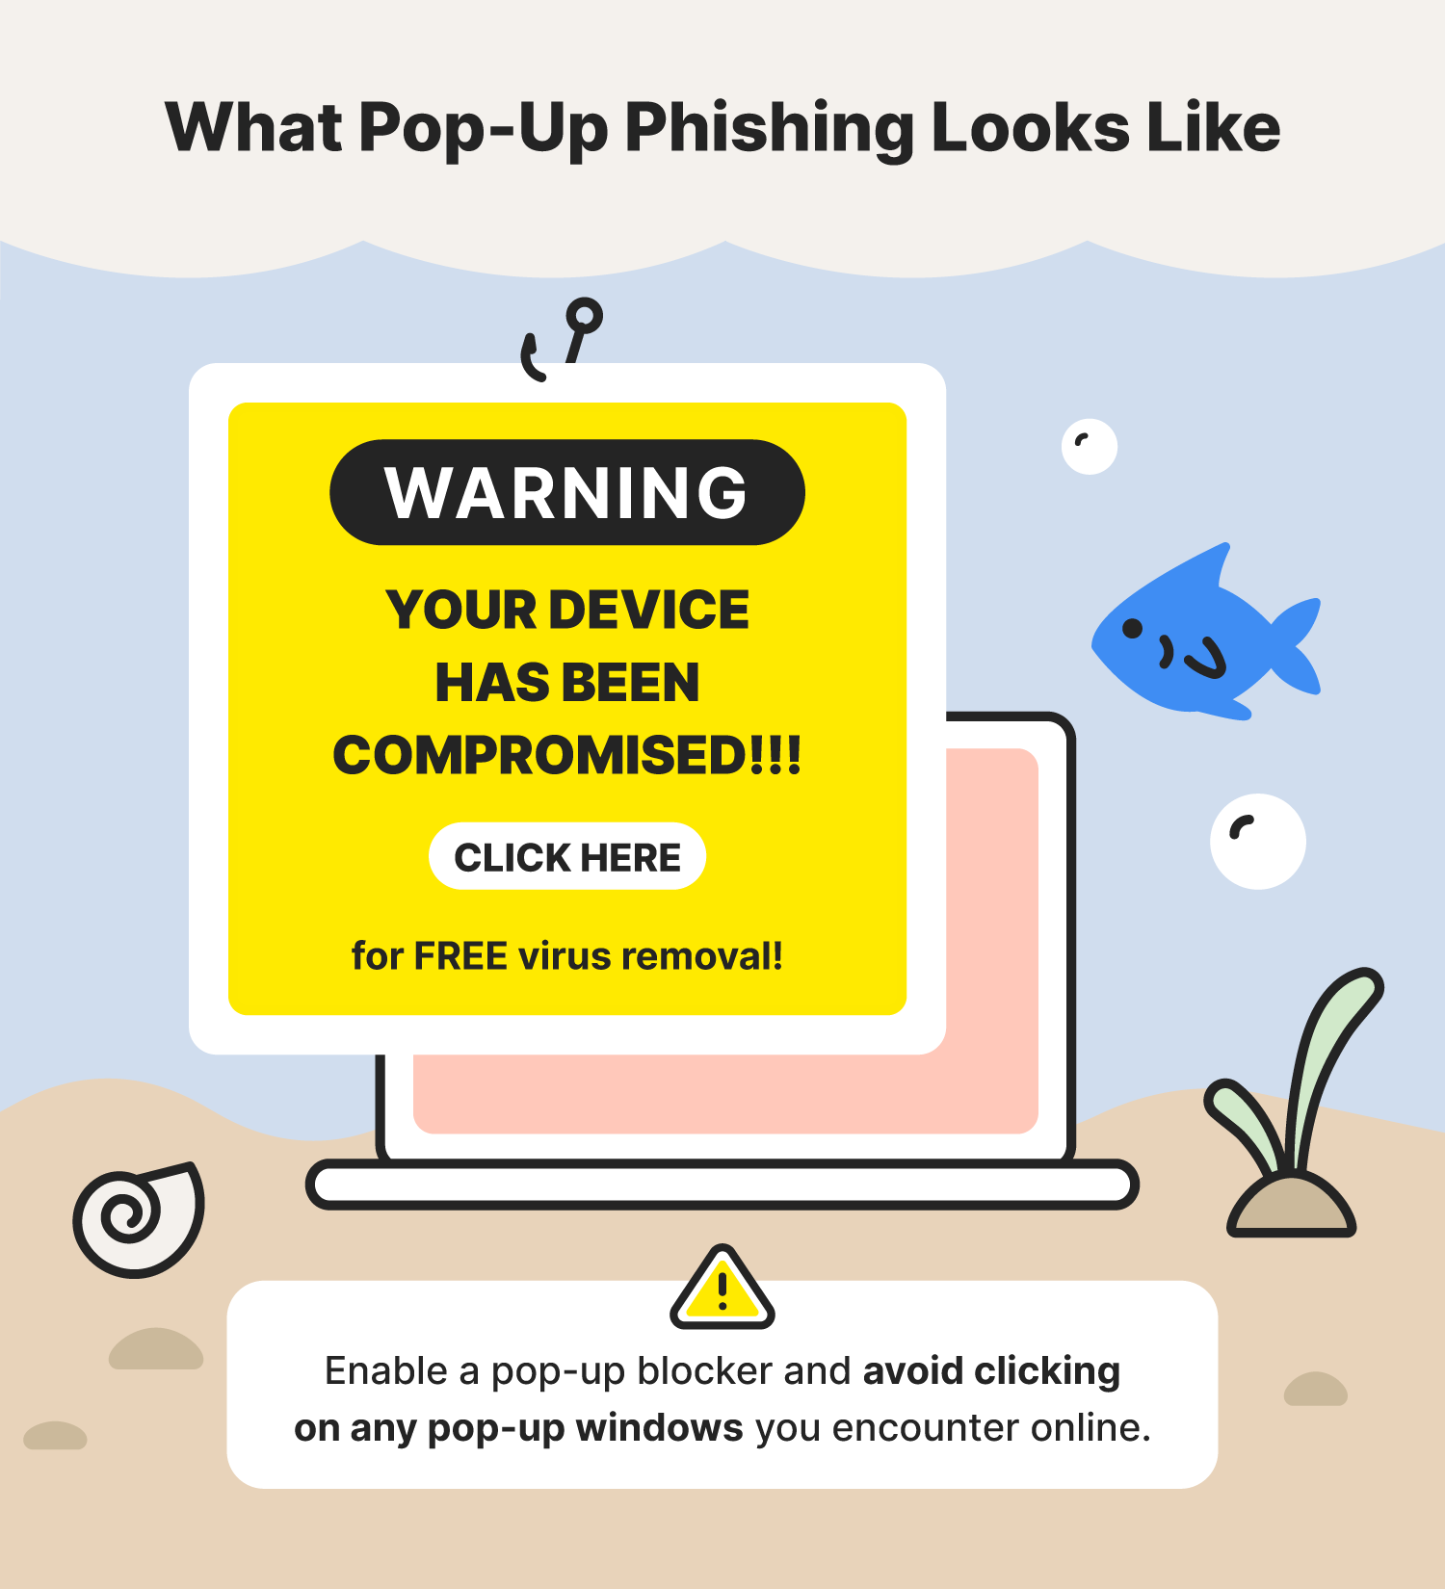
Pop up Advertisement
Random pop ups that uses adware to in attempt to get users to click on it and download malware to the computer
Feeds off of what users search most
Fake pop up notifications of being hacked

Slide 6
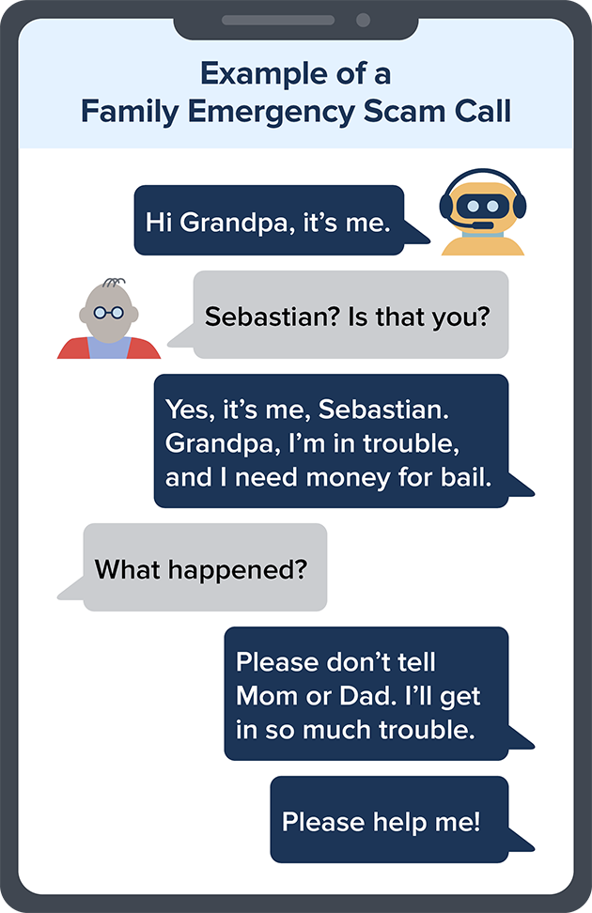
Most common cyber threats for seniors
Grandparent and Romance Scams
With Grandparent Scams, scammers will reach out to older individuals impersonating their grandchild, or someone in their care (school or hospital), the scammer will usually ask for money for the child.
With Romance Scams, scammers will pretend to be a love interest, and may even spend a long time communicating to build trust, they will usually ask for money as well.
What to watch out for?
Requests for money
Urgency
How to prevent falling victim to it?
Verify the claim with their parent or other relative, call the officials numbers of the school or hospital to check.
Do a background check.
Never send any sort of payment or give away any credit card or bank information.

Slide 7
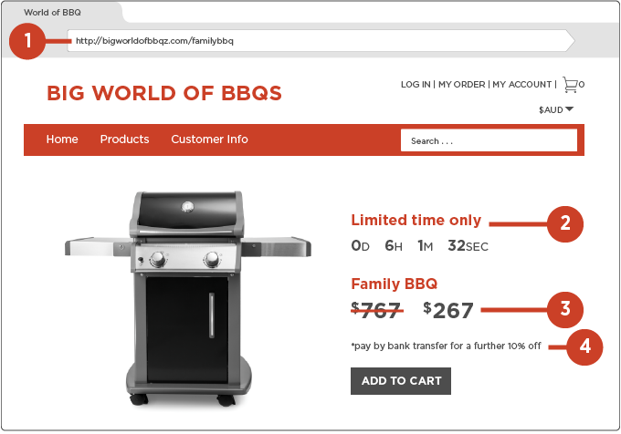
Most common cyber threats for seniors
How to prevent falling victim to it?
Check that the website is secure. Look for the padlock symbol on the address bar and check that the address starts with “https”.
Use resources like web searching “is site.com a scam” or enter the website address on urlvoid.com.
When paying, use secure payment methods like paypal or a credit card.
Avoid paying up front for goods via money-order, wire transfers or any unsecure payment methods.
Online Shopping Scams
Using online ads on social media, google and other websites, scammers will direct victims to fraudulent websites selling fake products.
When you make the purchase, they not only have your payment, but your financial information as well.
What to watch out for?
Unusually cheap products or huge discounts.
Store social media pages are very new.
Website has limited information about privacy, terms and conditions, contact details and other policies.

Slide 8

Hacking and Security Breaches
Trojan Attack:
Type of malware that downloads onto a computer disguised as a legitimate program.”
Evil Twin:
Spoofing cyberattack that works by tricking users into connecting to a fake Wi-Fi access point that mimics a legitimate network
Avoid Public Wi-Fi for Sensitive Transactions.

Slide 9

Best Security Practices
Use strong passwords: a password manager to help remember passwords.
Use antivirus software, either built in or from a reputable source.
Use 2FA (Two Factor Authentication) wherever possible to add an extra layer of security.

Slide 10

Citations
https://www.thesslstore.com/blog/5-ways-to-determine-if-a-website-is-fake-fraudulent-or-a-scam/
https://www.getcybersafe.gc.ca/en/blogs/how-older-adults-can-protect-themselves-most-common-cyber-security-threats
https://www.firstcolumbiabank.com/blog/account-protection/5-cybersecurity-threats-targeting-seniors-in-2023#:~:text=Phishing%20Scams&text=When%20cyber%20criminals%20phish%2C%20they,in%20order%20to%20defraud%20you
https://www.fdacs.gov/Consumer-Resources/Scams-and-Fraud/Online-Shopping-Scams

Slide 11
Any questions?

